Slide 1

Hierarchical Neural Network CS230 Project
Suresh Sugumar

Slide 2
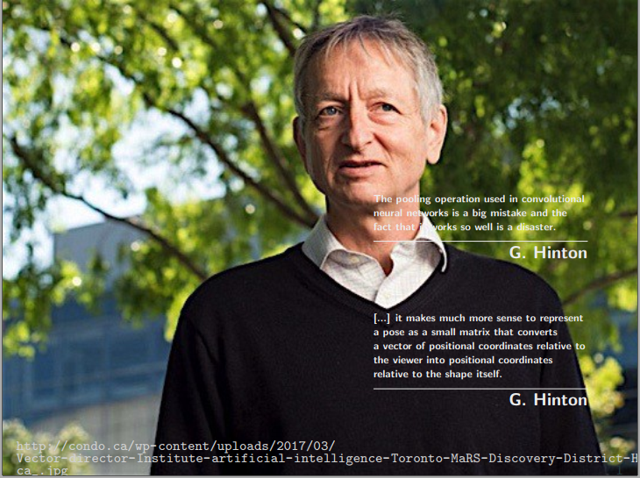
Motivation

Slide 3
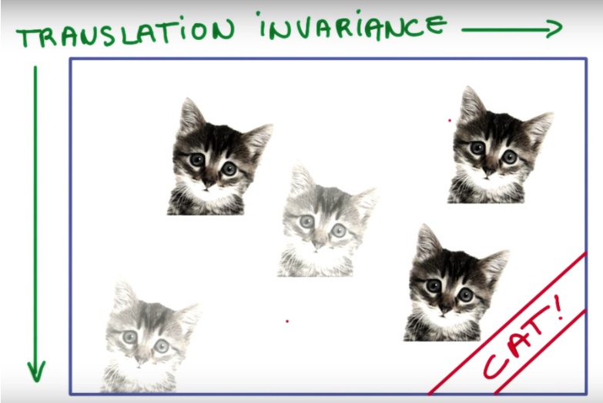
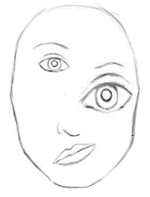
Drawbacks of CNN Architecture
Pooling layers (max pooling) results in poor translational invariance
Looses lot of valuable information during pooling
Ignores relation between the parts and the whole
To improve the translational invariance of CNN
Train network with lots of augmented data
Inefficient and waste of time and resources
But does not solve the problem completely
(source)
CNN
A human face
Is fooled

Slide 4
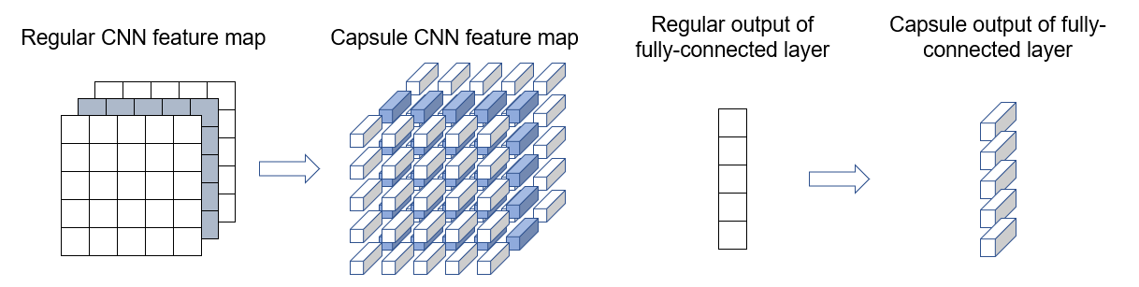
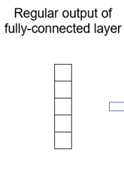
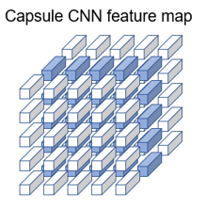
Capsules
A capsule is a group of neurons whose activity vector represents the instantiation parameters of a specific type of entity such as an object or an object part.

Slide 5
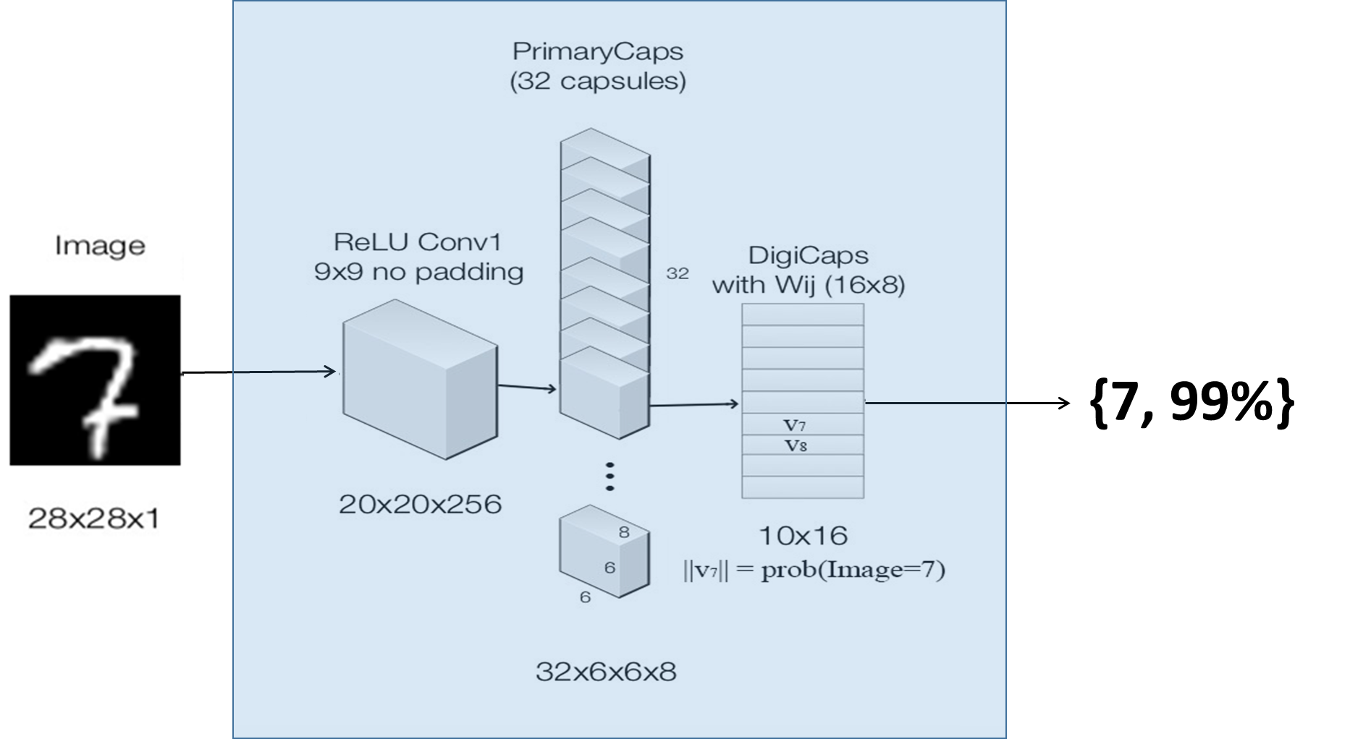
Example: Two level Capsule Network
Level 0 Capsules
Level 1 Capsules

Slide 6
Dataset
MNIST Handwritten Digits
Train set – 60000 examples
Test set – 10000 examples
Additional 500 images generated for testing, with following operations
Rotation Operation:
Overlap Operation:

Slide 7
Results

Slide 8
0
0
0
0
0
0
0 & 4
0 & 2

Slide 9
1
1
1
1 & 4
1 & 9
1 & 2
1 & 5
1 & 3

Slide 10
2
2
2
2 & 3
2 & 0
0
6
6

Slide 11
3
3
3
2 & 3
6
0
3 & 7
2

Slide 12
4
4
4
4
4
4
7
1

Slide 13
5
5
5
2
2
4
4
1 & 5
5

Slide 14

6
6
0
2
2
9
6
6
6

Slide 15
7
7
7
7
7
7
7
7

Slide 16


8
8
8
8
8
8
8
8

Slide 17
9
9
9
9
9
9
9
9

Slide 18
Drawbacks of Capsules Architecture
Longer training duration

Slide 19
GitHub
https://github.com/sureshsugumar/HierNet

Slide 20
References
Concept inspiration –
Sara Sabour, Nicholas Frosst, Geoffrey E Hinton. Dynamic Routing Between Capsules. arXiv:1710.09829, 2017.
MNIST Video generation – http://blog.otoro.net/2016/04/01/generating-large-images-from-latent-vectors/
Demo inspiration – https://github.com/lexfridman/mit-deep-learning/blob/master/tutorial_deep_learning_basics/deep_learning_basics.ipynb

Slide 21
Demo

